Slide 1
Deliberative Dialogue: A New Way of Talking Across Differences
Welcoming Pentecost: Seeing, Hearing, Loving As God Loves
Disciples of Christ Regional Conference
May 4, 2024
Davie, Florida

Slide 2
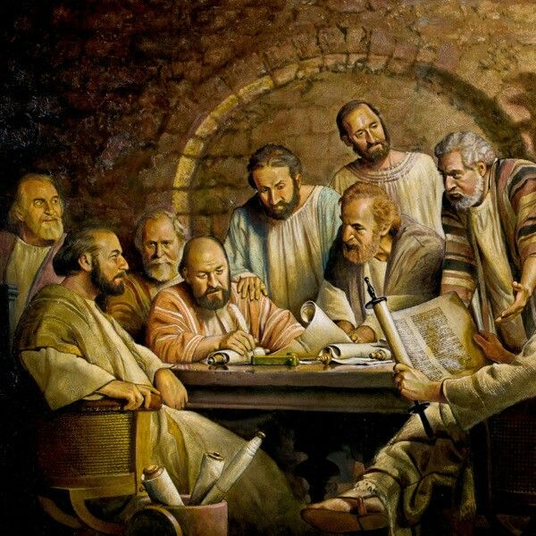
From Joy and Celebration to Hard Work
Acts 15:2 Antioch
Debate (Zeteseoos) – Search, questioning, and controversy.
Dissension (Histemi) – To make a stand, to set.
Acts 15: 6 Jerusalem
Consider (Analogizomai) – To consider, reason, think and decide, deliberate, make a judgement.
Dialogos – To see through to meaning, words that move to sort or choose.

Slide 3
Acts 15: 30-31
“So, they were sent off and went down to Antioch. When they gathered the congregation together, they delivered the letter. When its members read it, they rejoiced in exhortation.”

Slide 4
The Rev. Dr. Leah Schade

Slide 5
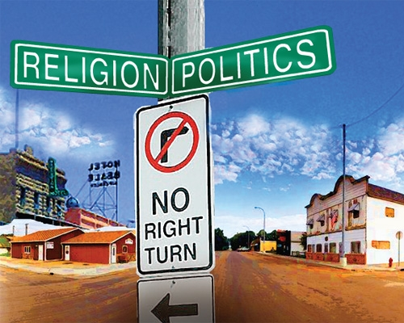
Deliberative Discipleship Deliberative Democracy
Notes:
I have been asked to help us think critically about what deliberative democracy might bring to the church especially relative to issues that are difficult to discuss.
I believe that the parish members with whom we work are disciples and, to quote Martin Marty, citizen believers.
We live in the tension between the Kingdom of God and the Kingdom of the World.

Slide 6
Key Issue
The mid-20th Century civil society where people worked to address public problems in voluntary associations, including religious organizations, has significantly eroded.
Today, many citizens are reluctant to become engaged in civic life much less politics, and trust in government is at an all –time low.
Notes:
HOW DO TOU RESPOND TO THESE STATEMENTS?
Here are three important problems of democracy:
Citizens play an increasingly narrow role in public life.
Some citizens may find it difficult to make sound decisions together.
They react hastily
Self-interest v public interest
Even if citizens make sound decisions together about the issues
facing them, they may find it difficult to act together to move
forward.
Citizens often do not have the habit of working with one
another in the public realm.
Research indicates that fewer people join voluntary organizations, read newspapers, work on community projects, and attend public meetings today contrasted to even 25 years ago.
The ELCA is experiencing membership erosion and other challenges.
At the same time, Lutherans have a strong heritage of public service. 1 IN 5 BENEFIT FROM LSS

Slide 7
Key Questions
Question #1
Should the Church play a role in revitalizing civic life and helping American society become more just?
If so, Why?
If not, Why not?
Notes:
These are questions I hope we can discuss today.
The Church has always been an agent of change.
We talk about giving ourselves away for the Gospel.
What thoughts do you have?

Slide 8
St.-Martins-in-the-Fields Ten Point Charter
#10
We are committed to identifying and affirming what is good and identifying and opposing what is evil, and living as best we can in the mess in the middle.
Notes:
On a trip to England, we worshipped at St. Martins and discovered the parish Ten Point Charter.

Slide 9
Key Questions
Question #2
What prevents faithful, citizen believers from discussing and acting on society’s messy issues?
Notes:
What examples can we list?

Slide 10
How can we address public problems?
“The standard answer is that we need better leaders. The real answer is that we need better citizens.”
Thomas Friedman
Notes:
Thomas Friedman was asked about the many difficult problems we face in America today.
His answer? (QUOTE ON SLIDE)

Slide 11
Premise
Deliberative dialogue is a form of communication aimed at finding the best course of action.
The deliberative process has the potential to complement the Church’s social teaching and policy work, especially at the parish level.
Notes:
In a few minutes I want to introduce the characteristics of deliberative dialogue.
Having worked with social statements in the parish, I always wanted tools to help stimulate conversation.

Slide 12
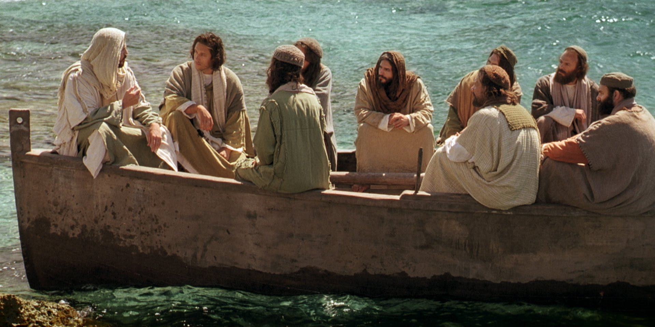
Where do we find deliberation in the Gospels?
Notes:
Are there texts or Gospel stories that come to mind?

Slide 13
Parables
“The parable is a question waiting for an answer, an invitation waiting for a response. It does not really “exist” or function until it is freely appropriated.” John R. Donahue, SJ
Notes:
I did my seminary studies at the Graduate Theological Union in Berkeley.
I took worship courses at CDSP, church history and homiletics at PLTS, and most of my Biblical studies at the Jesuit School of Theology Berkeley.
Father John Donahue, one of my favorite seminary professors. He wrote The Gospel in Parable.

Slide 14
What are the Parables?
C.H. Dodd
Drawn from nature or common life
Arrest the hearer by vividness or strangeness
Leave the mind in sufficient doubt about its precise application to tease the mind into active thought
Engage us with minor characters and challenge us to make some judgment
Notes:
I believe Jesus’ parables offer an illustration of an invitation to dialogue among the disciples and those who followed and welcomes Jesus on his journeys.
Dodd’s definition of a parable has similar characteristics to deliberative problems.

Slide 15
Jesus’ Parables
The parables “share in the dynamics of oral, interpersonal dialogue.” John R. Donahue, SJ
“At its simplest the parable is a metaphor or simile drawn from nature or common life, arresting the hearer by its vividness or strangeness, and leaving the mind in sufficient doubt about its precise application to tease it into active thought.” C.H. Dodd

Slide 16
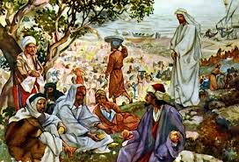
Parables
Jesus’ parables are provocative. They encourage and stimulate moral deliberation.
Orient
Disorient
Reorient

Slide 17
What are Common Problems? Today’s Parables
A community issue of broad concern for which choices have to be made by diverse groups of people.
There are no clear right or wrong answers as the issue involves value conflicts and underlying paradoxes that are difficult to resolve.
“Solutions” are rarely found, and the conversation will always continue, yet deliberators are encouraged to make judgments regarding positive actions.
Notes:
There are problems that call for technical answers.
There are other public problems where officials expect citizens rubber stamp for an issue already determined.
But there are many social problems that are complex, nuanced and require prayerful discernment and civil discourse.

Slide 18
Parables of the Vineyard Workers
Parable of Workers in the Vineyard, Matthew 20
Coalition of Immokalee (FL) Workers
Notes:
Consider the parable of the Vineyard Workers in Matthew.
Donahue suggests that the parable has three acts
The Hiring
The Payments
Dialogue among the vineyard owner and the grumbling workers.
Why do the workers complain?
How does the owner respond?
How is justice advanced in the parable?
Donahue says that “hardly any parable in the Gospels seems to upset the basic structure of an orderly society as this one.”
Kingdom of Earth value - Equal pay for equal work.
Immokalee Farm Workers as a contemporary parable. The coalition recently negotiated a one penny per basket increase in wages.

Slide 19
The Church and America’s Common Good?
Churches as “schools for democracy” in Colonial and Constitution eras
Social Gospel Movement
Civil Rights
Immigration and Refugee ministry
Social and policy statements
Advocacy efforts
Notes:
The Church is a significant institution in American society.
Some referred to Colonial and Constitutional era churches as “schools for democracy.”
Yet, some Lutheran historians speak of quietism among their leaders and members.
The 18th and 19th centuries Social Gospel movement addressed the impact of industrial American and growing poverty.
The Civil Rights Movement.
By the middle of the 20th Century church denominations began addressing public issues from a perspective of faith.

Slide 20
Common Issues
EVANGELICAL LUTHERAN CHURCH IN AMERICA | Disciples of Christ | NATIONAL ISSUES FORUMS INSTITUTE
Caring for Creation | Green Chalice | Climate Choices
Our Calling in Education |  | 21st C Mission for Schools
Caring for Health |  | Health Care: How Can We Reduce the Costs and Still Get the Care We Need?
Sufficient, Sustainable Livelihood for All | Poor Peoples Campaign 12 Core Principles | Making Ends Meet: How should We Spread Prosperity & Increase Opportunity?
Race, Ethnicity, & Culture |  | Racial and Ethnic Tensions
Immigration | Refugee and Immigration Ministries | Immigration in America
End of Life Decisions |  | Life and Death Decisions
Notes:
I want to offer a comparison of issues that both the Church and secular organizations care deeply about.
I am more familiar with the process that leads to ELCA social statements and messages.
NIFI has been producing dialogue materials for nearly 40 years.
The Church produces educational materials and formal documents.

Slide 21
Deliberative Dialogue
“To deliberate is to carefully weigh civic actions, laws, or policies against the various things that people hold dear in order to settle on a direction to follow or purpose to pursue.”
David Mathews.
Notes:
I have been learning about and teaching deliberative democracy for several years.
I believe the deliberative dialogue method complements the church’s communal discernment.
How do we bring the Gospel to bear on some of society’s messy issues?
I believe deliberative dialogue offers the church a tool.

Slide 22
Responsibility Ethics
“Responsibility ethics recognizes human beings primarily as dialogical creatures. It sees human beings as answerers who live through response and interaction. The focus is on discerning what is a fitting response within the extremely complex situations of contemporary life that always include manifold competing demands and moral challenges.”
Willer, Roger, Community of Moral Deliberation and an Emerging Responsibility Ethic, Journal of Lutheran Ethics, 2014
Notes:
One of my first tasks for a Kettering research project called Religious Organizations and Community Building involved doing a literature review.
I searched for the way Christian, Jewish, Muslim, and other religious groups helped their members at the congregational level think about social issues.
One of the most enlightening articles I came across was written by Pastor Roger Willer. ELCA Director for Theological Ethics.
In addition to the quote on the screen, he wrote of the church’s social statements, “I should say the teaching is relatively comprehensive because a couple of evident gaps exist. For example, work is only now beginning on women and justice, and ELCA documents have not sketched an adequate political ethic regarding the nature, role, and scope of government or related questions around the nature of citizenship or civic duty, taxation, etc.”
Dr. Willer and I are working on several writing projects together.

Slide 23
The Deliberative Democracy Process
Shaping Our Future: How Can Higher Education
Help Us Create the Society We Desire
Notes:
I want to use a short video we produced at Georgia College several years ago to describe what we mean by deliberative democracy and deliberative dialogue.

Slide 24
Three Primary Forms of Politics
Adversarial Politics
Administrative / Expert Politics
Deliberative Politics
p. 4-9
Notes:
Adversarial Politics
Administrative/Expert Politics
Deliberative Politics

Slide 25
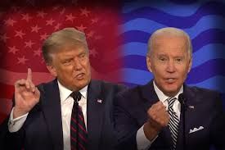
Adversarial Politics
Notes:
I will leave you to your own thoughts about the current political rhetoric and debates.
Debates are often structured as polarities. Pro and con sides to an argument.
We are spectators.

Slide 26
Expert Politics
Notes:
C-SPAN is an example of expert politics.
Experts offer analysis, facts, trends, observations, but often stop short of providing definitive recommendations.
Audience members have an opportunity to interact with the experts but are by and large spectators.

Slide 27
Deliberative Politics
Notes:
Note the posture in the three photos!
GO BACK TWO SLIDES
This is a community deliberative forum in Georgia where people shared their ideas about the university’s relationship with the community.

Slide 28
Three Forms of Communication
Debate
Dialogue
Deliberation
Notes:
Deliberative Democracy is choice work. In the deliberative process, the moderator works hard with forum participants to arrive at some collective judgments.

Slide 29
Three Key Communication Tools
for Interactive Community Problem-Solving
Debate | Conversation | Deliberation
Contest Compete Argue Promote opinion Seek majority Persuade Dig in Tightly structured Express Usually fast Clarifies Majoritarian | Explore Exchange Discuss Build relationships Understand Seek to understand Reach across Loosely structured Listen Usually slow Clarifies Non-decisive | Choose Weigh Decide Make decisions Seek overlap Seek common ground Framed to make choices Listen Usually slow Clarifies Complementary Decisive
Notes:
I would argue that we could add another column called DISCERNMENT and list the qualities that the ELCA Task Force of Communal Discernment conveyed in their report.
I believe deliberative dialogue corresponds to communal discernment.

Slide 30
Public Opinion to Public Judgment
Stage 3: Resolution
Stage 2: Working Through
Toward Wiser Public Judgment, Yankelovich, Daniel, 2011
Stage 1: Consciousness Raising

Slide 31
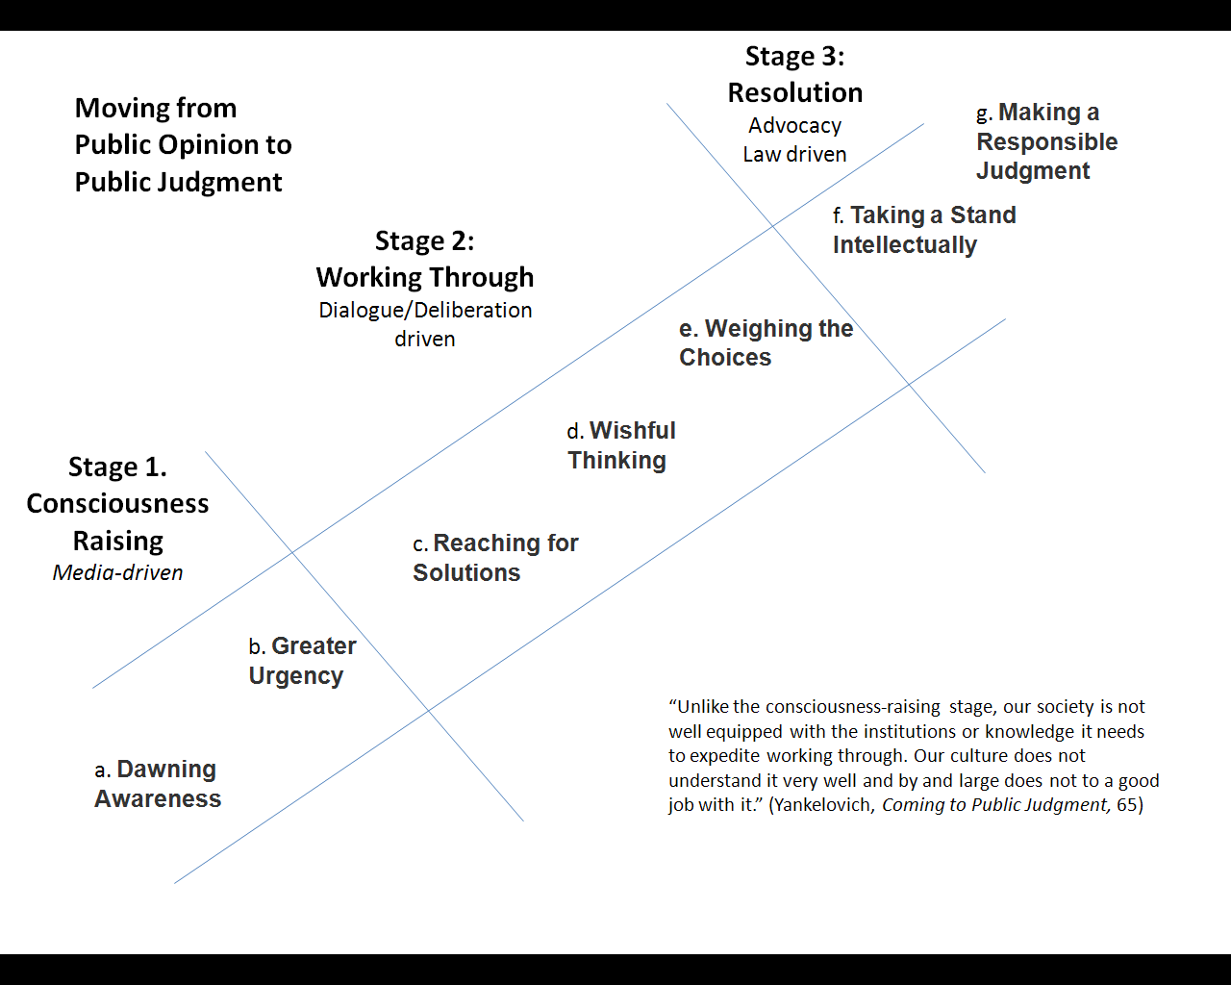
Moving from Public Opinion to Public Judgment
p. 13-14
Notes:
Perhaps the most important skill lifted up in the deliberative dialogue movement is LISTENING.
Listening to the “other.” Appreciating the different perspectives of others.
DD invites us to share our opinions, but we are also challenged to move beyond the “I” to the community – Ubuntu – and think about what common agreement the group might achieve.

Slide 32
Four Key Tasks of Deliberative Practice
Issue Analysis
Reach consensus and name a common problem
Frame multiple approaches to the problem
Convening
Seek an inclusive group of participants
Facilitating & Deliberating
Provide neutral and skilled moderation for participants to deliberate and make choices/judgments
Reporting
Share the results with the appropriate decision makers
Notes:
This is the concise description of the deliberative process.
We will take some time after the break to experience a deliberative forum.

Slide 33
Decision-Making informed by Dialogue and Deliberation
Dialogue
Bringing together many voices, stories, perspectives
Shared inquiry, exploration, discovery
Deep listening that fosters respect and understanding
Shared meaning-making and co-construction of knowledge
Ascertaining values that undergird opinions
Decision-making
Authority decides
Negotiation
Consensus
Vote
Deliberation
Reasoned argument
Serious examination of possible solutions
Careful weighing of tradeoffs
Reasoned and informed judgment
from Democratic Dialogue—A Handbook for Practitioners
Notes:
This is another way of illustrating the process.

Slide 34
Positives & Negatives of the Deliberative Process
Positive
Citizens are involved and trusted to share ideas.
Civil discussion is supported by neutral facilitation.
Increased participation in democracy.
Transition from expressing personal opinions to making collective choices.
Negative
The process requires an extensive amount of time.
Convening diverse groups of people is very hard.
Convincing elected leaders to trust the public’s voice in the midst of the lobbying culture is a challenge.
Notes:
We live in an age where many of us like to get our questions answered instantly.
Let me “Google that!”
Naming a problem, researching and developing teaching documents, framing dialogue resources, and analyzing forum results takes time.
Meaningful and sustainable change takes time, patience, and persistence.

Slide 35
WHO ARE THE KEY PLAYERS?
A CONVENER Someone who brings people together to talk
A MODERATOR Responsible for getting people to weigh choices and listen to each other
PARTICIPANTS The real drivers of deliberative forums
A RECORDER Records key themes , concerns, and questions

Slide 36
WHAT DO PARTICIPANTS DO IN A DELIBERATIVE FORUM?
Look at different ways of thinking about a problem
Exchange views with others
Weigh benefit and trade-offs of different approaches
Listen and reconsider in a safe environment
Notes:
To help people weigh different options and approaches
To give people a chance to hear other perspectives and points of view
To help people look closely at the risks and trade-offs of different approaches
To help people test their own thinking in a safe environment where everyone is committed to listening and reconsidering initial thoughts

Slide 37
What to Expect and Not Expect from a Good Forum
A civil and respectful atmosphere.
Exchange of diverse ideas.
Appreciation for nuances.
A deeper understanding.
Respect for areas of agreement and disagreement.
Consideration of possible next steps toward addressing the issue.
Minds to be significantly changed.
Consensus.
An action plan.
Quick change or resolution.
All forum participants actively committed to problem-solving.
A community that immediately embraces the deliberative process.

Slide 38
FORUM STRUCTURE
Welcome the participants and thank the host.
Share the Deliberative Dialogue Guidelines.
Begin the forum with the “Personal Stake” where participants introduce themselves and offer a one or two-sentence personal comment of concern about the issue.
Introduce Option #1 and begin the dialogue. Repeat for Options #2 and #3.
Begin the reflection portion of the forum.
Encourage participants to complete the post-forum questionnaire.

Slide 39
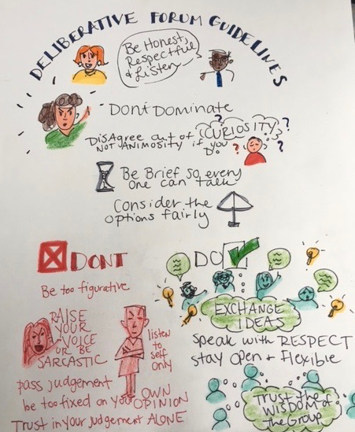
Forum Guidelines
Focus on the options. All options should be considered fairly
No one or two persons should dominate.
Everyone is encouraged to participate. Use “I” language.
Maintain an open and respectful atmosphere.
Listen to understand.
Disagree our of curiosity not animosity.
Be open to agreement or common ground.
Be open to the Holy Spirit.

Slide 40
The Personal Stake
In a sentence or two and from the heart please respond to one of the following questions.
What makes this issue real for you?
Why are you concerned?
Example – “I want my grandchildren to understand the United States as a country of opportunity and justice where all can prosper and be happy.”

Slide 41
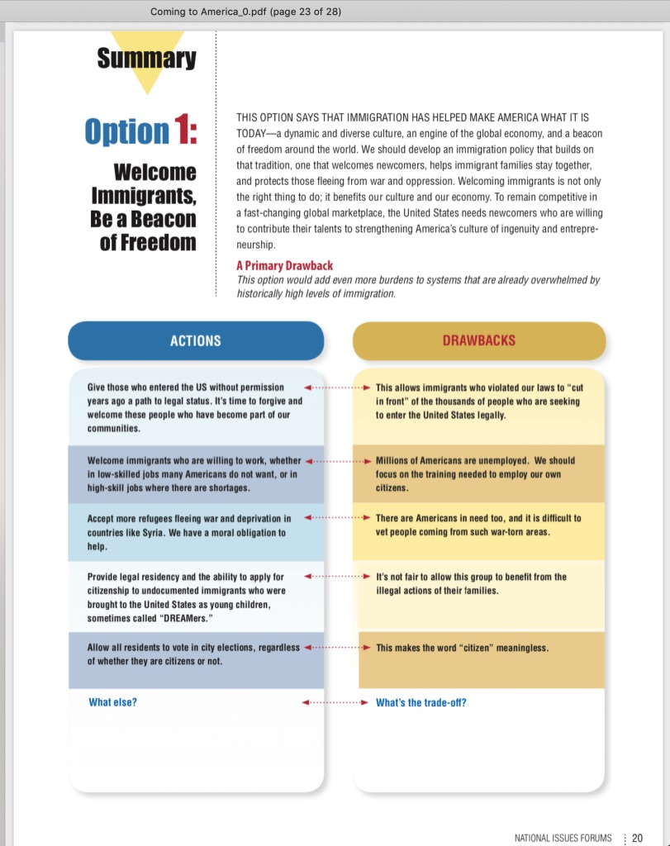
Issue Guides have summary pages that are often used to guide the dialogue.
NIFI Issue Guide Summary Page
The Introduction offers an abbreviated version of the material on the issue guide’s pages devoted to the first option.
Options, sometimes called “approaches” or “challenges” provide a theme for dialogue and have an underlying value, in this case “welcoming the stranger.”
The Primary Drawback summarizes the tradeoff or potential consequence of the option.
Drawbacks or “tradeoffs” define possible consequences. In order to move forward with the action, citizens might have to give up something. Are we willing to trade off x to pursue y?
Actions or “examples of what could be done” provide specific efforts to address the issue. They are starting places for dialogue.

Slide 42
ACTS 15 – The Options
Option #1 Abide by the Pharisee leaders’ interpretation of Moses’ Law.
Option #2 Value Peter’s role as God’s designated communicator to the Gentiles.
Option #3 Prepare and deliver a letter to the Gentiles explaining qualifications for participating in the faith.

Slide 43
The Church’s Role in A Divided Society What should the church do to help congregants navigate the current state of political discourse in America?
Option #1 The Church as Refuge
Maintain separation of church and state
Option #2 The Church as Mediator
Educate people to express their faith relative to social justice and public policies.
Option #3 The Church as Prophetic Voice
Speak to the cultural and political issues of the day.

Slide 45
Reflection – Common Values, Common Ground
What did we learn from one another?
Agreement or Common Ground?
Agree to Disagree?
Tensions?
Next Steps?

Slide 46
Thank you!!
Rev. R. Gregg Kaufman
gkaufman8@mac.com
(478) 960-3203
A Different Way of Talking, Journal Of Lutheran Ethics
Please contact me should you want more information.
Another great resource: NIFI.ORG

